Slide 1
RDBMS PROJECT
Waste Management
Waste Management
At Local Self-Governing Body level

Slide 2
CONTENTS
TEAM MEMBERS
ABSTRACT OF THE PROJECT
INPUT DATA AND THE OUTPUT DATA
LANGUAGES AND TOOLS USED
SOFTWARES USED
GANTT CHART

Slide 3
TEAM MEMBERS
LEO JOY
MOHAMMED HISHAM A
VAISHAK VINODKUMAR NAIR
SAURABH KUMAR

Slide 4
PROJECT ABSTRACT
WHY WASTE MANAGEMENT?
Thinking of a topic for our project; We always desired to address one of the major issues that our society seem to be facing now and we couldn’t ignore the topic of waste-management.
The irresponsible disposal of non-biodegradable waste into barren fields and alongside roads have made our localities look ugly and turn filthy. At the same time no proper methods to treat bio-degradable waste and food waste has led to the extensive dumping of these wastes into open spaces and nearby water bodies in our localities.
There are numerous methods but those haven’t been technically sound enough to deal with the current situation; hence we thought of coming up with a more systematic system.
OUR SOLUTION
We intend to call technology to aid this problem and find a solution which can connect both the authorities and the local citizens to work on the issue rather constructively and hence beautify our local bodies and as a whole our state.
We are planning to use the principles of RDBMS and equip the government systems with details and ways of waste management and help them easily communicate the same with the citizens.

Slide 5
INPUT & OUTPUT DATA
INPUT DATA
House No.
Survey No. Collected in database
Ward No.
Other data attributes.
OUTPUT DATA
Nearest garbage collection centre and waste treatment centre.
In case on unavailability of such a centre the useful information will be communicated by officials in person.

Slide 6
LANGUAGES USED
Frontend:
HTML CSS JAVASCRIPT TYPESCRIPT
Server Scripting:
PHP
Database:
MYSQL

Slide 7
TOOLS AND SOFTWARES USED
MYSQL server
VS Code
PHP
Notepad++

Slide 8
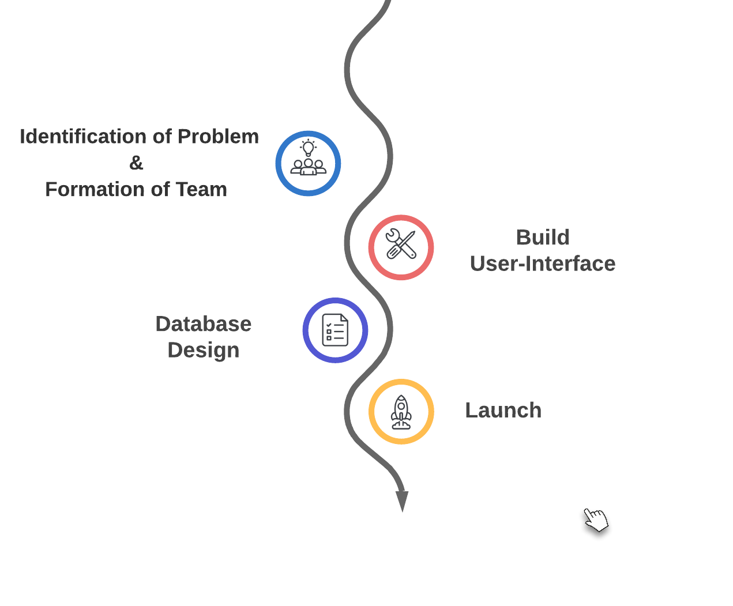
GANTT CHART

Slide 9
